Slide 1

PartyPlanner
by Emily Bradfield

Slide 2
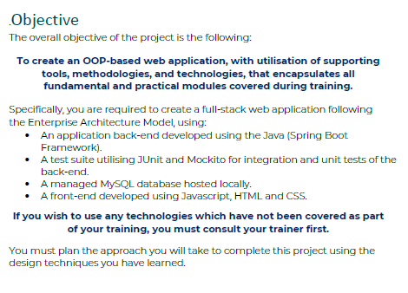
Introduction
A website designed for assisting with planning parties and managing guest RSVPs
Simple, effective, with database integration through an API
Separate account types for host and their guest
Login redirects to appropriate page
Different functionality allocated to each
Host has full control over guest list (create, read, update, and delete)
Guests have control over account settings
Responses sent from guests through website
Host can amend and share party details as they see fit
Each guest can only update their own account
Who am I, and what is PartyPlanner?

Slide 3
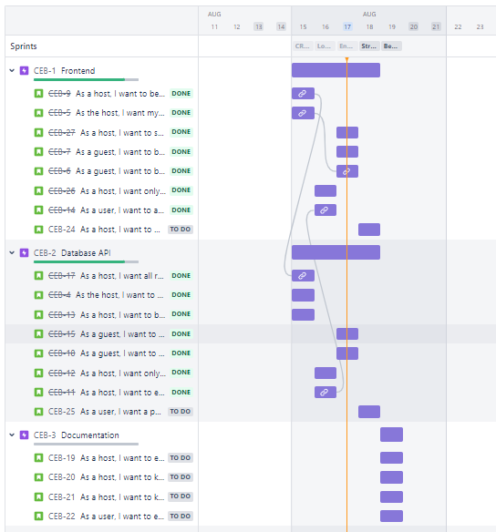
Conceptualisation
How did I approach the task?
Assess and consider MVP -> CRUD functionality
Separate MVP from final concept and break down individual tasks
Consider priority of non-MVP tasks
Develop Jira Board (scrum) with 5 sprints (one per day)
Ensure sprint one produces MVP
Separate remainder of concept into features; allocate to sprints
Compare goals with current knowledge, resources, and timeline
Review priority and storypoints, note down specific tasks required of each user story

Slide 4
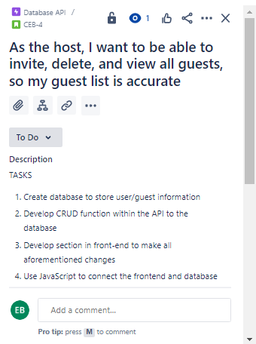
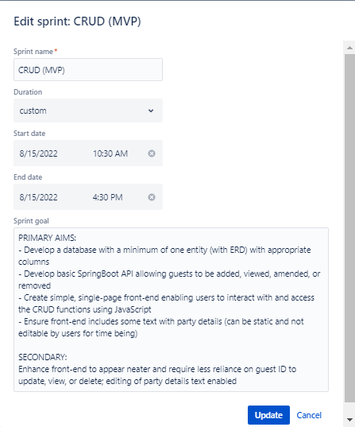
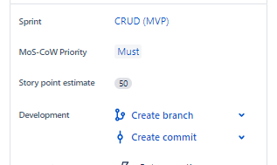
Sprint One: CRUD (mvp)

Slide 5
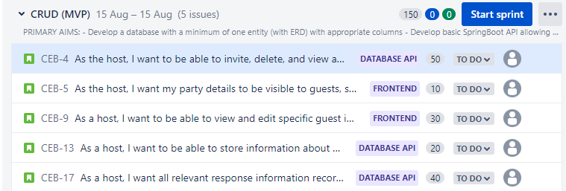
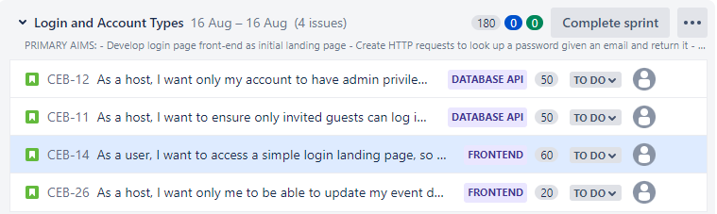
All Sprints – My RoadMap
THE GOAL:
Create the minimum viable product; a website with CRUD functionality communicated through an API to a Database
THE GOAL:
Develop a functional login page, redirecting users to the appropriate section, and separating host/guest function between

Slide 6
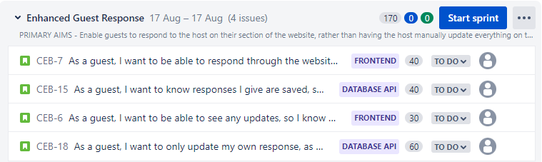
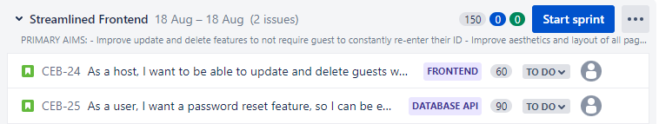
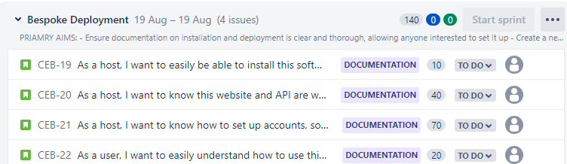
All Sprints – My RoadMap
THE GOAL:
Relocate the response function to guests and introducing “edit event details” to the host
THE GOAL:
Finetune frontend design and enhance user experience
THE GOAL:
Finalise post-production documentation, introduce initial setup features enabling easier implementation

Slide 7
Consultant Journey
Front End
HTML: creates the structure
Applying skills from QA
Understanding DOM
CSS: creates the style
Improved bootstrap implementation
JavaScript: creates the control
Understanding functions how they interact
Working with Axios for HTTP requests
Using localStorage to enable features
Using DOM to my advantage
Database and API
MySQL: the database
Applying previous skills and knowledge
Implementing JPA to communicate with Java
Understanding entity relationships
SpringBoot: the API
Developing CRUD functionality through HTTP requests
Use of repos, services, controllers, and domains
Ensuring separation of function as appropriate
Repeated and consistent testing throughout development

Slide 8

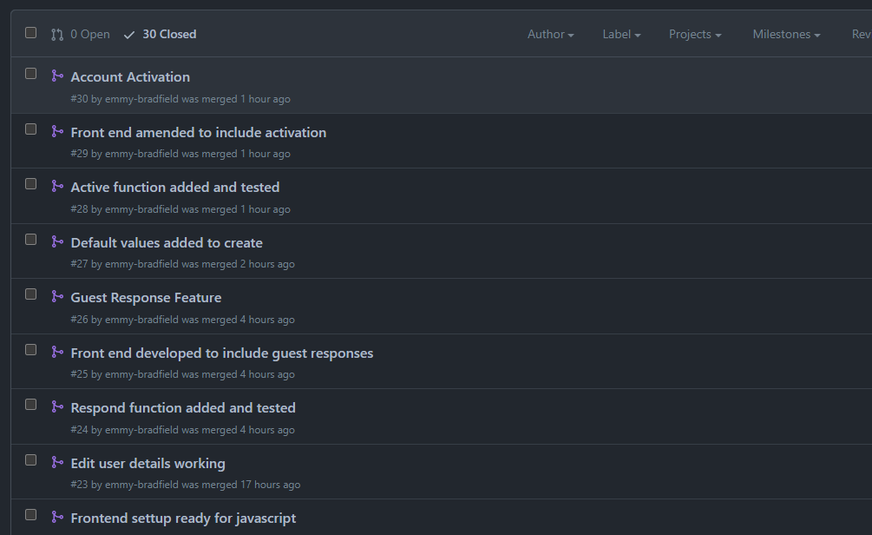
Version Control
Through Git Bash and GitHub, the master/dev/feature model can be implemented to reduce risks when changing code or introducing features.
Document branch additionally used to separate development and documentation

Slide 9
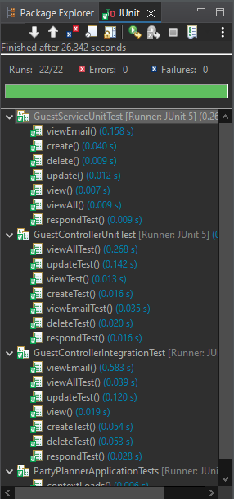
Testing
Unit Testing on GuestService with Mockito and Assert Equals
Unit Testing on GuestController with Mockito and MockMvc
Integration Testing on GuestController with Mockito and MockMvc
FINAL COVERAGE: 96.7%
FINAL COVERAGE:

Slide 10
Demonstration

Slide 11
HOW DID IT GO?
Sprint Review
SPRINT ONE
All tasks completed by end of day one and documented throughout
SPRINT TWO
All tasks completed by end of day, UMLs and Risk Assessment additionally completes and committed
SPRINT THREE
All tasks including “would” task completed by hallway through, presentation developed
SPRINT FOUR
Started sprint early, did not complete one user story – added to final sprint
SPRINT FIVE
Did not complete user story added from previous sprint, but completed all other sprint 5 tasks

Slide 12
HOW DID I LEARN?
Sprint Retrospective
PROJECT STRENGTHS
Completed all tasks in 4/5 sprints
Had sufficient time and room to expand on initial concept
Development focused on one feature at a time
MVP achieved and exceeded
AREAS OF GROWTH
Define epics to avoid homogeneity between them
Review approach to storypoint allocation
Balance goals and timeframe

Slide 13



Conclusion
MY FINAL TAKEAWAY
What went well…
Finished product which look good and works well
Developed own knowledge through research
Effectively managed time and MVP
I can grow from…
Reviewing approach to storypoint rating
Understand impact of documentation on planning
Project potential…
Introduction of SMTP protocol
Expansion of response options
Party entity and structured party details

Slide 14
Any questions?
Thank you for your time!

